Slide 1
TypeScript:
Superheroic Power In Angular
2016.12
Radoslav Kirov
Zhengbo Li

Slide 2
Outline
Why TypeScript?
Getting Started with TypeScript + Angular
Notes:
What problems
Design philosophy
Demo TypeScript in action

Slide 3
Why TypeScript?
Section II
Section III
Why TypeScript
What issue are we solving?

Slide 4
Big JavaScript apps are hard.
Notes:
In MS, we see pattern
Project size grow -> hard to maintain (no easy way to refactor. Cannot safely change variable name) -> more code more features -> impossible to reason about -> rewrite

Slide 5
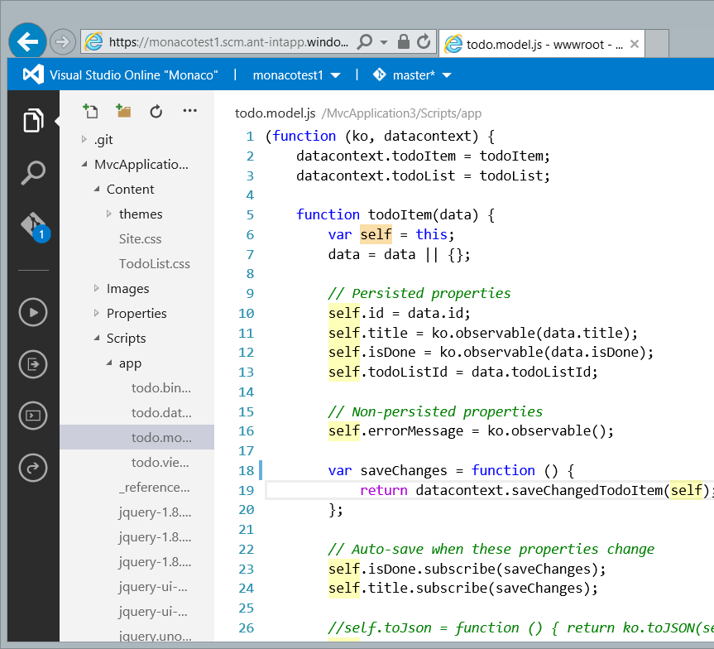
Monaco (Visual Studio Code)
Million lines of JavaScript code
Notes:
New Ide Visual Studio code
Folks love it because how snappy it is
Entirely written in TS
Used to be JS
Experience wasn’t great

Slide 6
JavaScript alone is not enough.
Notes:
What can we do?
Comparison to other languages proven to handle large project
Types -> enforce code contract
Module -> isolate to meaningful pieces

Slide 7
The Feature Gap
ES2015
ES2016
ES2017
ES2018
ES3
ES5
JavaScript Evolution
State of web JS
State of server JS
State of the art JS
Target
Productivity
JavaScript feature gap
June 2016
Notes:
Admittedly, efforts.
Catch: gap between a new langage feature design is finished -> you can used it in major platforms.
When ES6 comes out, all major browsers only support es5
Cannot use in production.
Given up productivity for compatability
Animation

Slide 8
TypeScript:
A typed superset of JavaScript that compiles to plain JavaScript
Notes:
Based on these observations

Slide 9
Any browser. Any host. Any OS.
Open Source.

Slide 10
Demo:
JavaScript to TypeScript
Notes:
5 min
Mention VSCode
text size bigger
Go to definition
Misspelled writeble
What happened if it is js
Show Compiler phase
Explain why “any” happens

Slide 11
Outline
Demo Recap
Benefits from TypeScript today
Compile time type checking
Opt-in gradual type system
Use future JavaScript feature now

Slide 12
The TypeScript Language
Types
JavaScript
TypeScript Compiler
JavaScript
Notes:
Not only types optional, you can choose how strict you want the type system to be by setting compiler options.
As strict as possible
Zero friction with existing javascript workflows
might be too abstract
Show in demo
Compare function sendEmail(addr) with the modified one

Slide 13
One Input, Targets All
ES6
ES6
TypeScript Compiler
TS
ES5
ES5
ES3
Notes:
Not only use new features, but also different targeting platforms.
No need to change a single line of code
Compile again the previous demo changing targets

Slide 14
JavaScript IS TypeScript
Future …
ES7
TypeScript
ES6
ES6+
ES5
ES5
Notes:
Future proof.

Slide 15
JavaScript IS TypeScript
Notes:
Zero friction.
If you knew js, you already knew a large part of TypeScript.

Slide 16
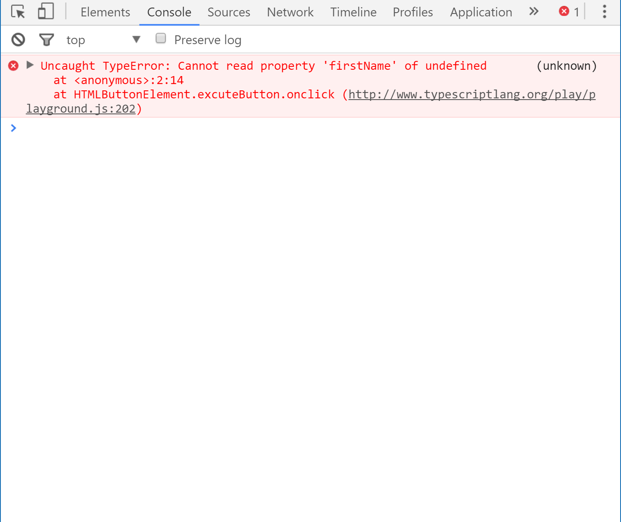
JavaScript’s Billion Dollar Mistake
Notes:
Read it out
Many errors and exceptions happen because we called a property or method on a undefined object.
获得属性 调用方法
Happen so often because it is very easily overlooked.
Either missed -> unsafe or over-checked -> ugly code;

Slide 17
Demo:
Type checking in action
Notes:
Quiz format from the beginning
Typeof === “Object” -> null
Keep talking

Slide 18
Outline
Demo Recap
Type Checking in Action
Managing nullability in JS is error-prone
Non-nullable types provide null/undefined coverage
Control flow analysis traces flow for you

Slide 19
Getting Started with TypeScript + Angular
Section II
Section III
Why TypeScript
What issue are we solving?

Slide 20

TypeScript + Angular
In late 2014, AtScript was announced at ng-Europe
We started to discuss about combining efforts
Enhanced ES6 support
Implemented @decorators
Added support for SystemJS
Improved tooling for non-Windows platforms and various editors
Notes:
2014 angular team atscript, same motivation to solve the large js development problem
Why aren’t we work together
We reach out, discussed requirement, then decorator / systemjs / ES6 support
Tooling / tsserver -> other platforms

Slide 21


❤
TS
Notes:
The love is not only for Ng 2.
Many folks are still using Angular 1 and thinking about migrating to Angular 2.

Slide 22
Demo:
Migration from Angular 1
Notes:
Angular 1.5 component model
Move the function and replace with constructor
Explain “tsc --init”
Watch mode
Property (you don’t misspell)
Careful about wording “you don’t ever need to xxx in TypeScript”

Slide 23
Angular 2 and TypeScript
Section II
Section III
Why TypeScript
What issue are we solving?
Notes:
migration tools,

Slide 24
Angular 2 ergonomics are great with TypeScript
Notes:
While Angular1 works great with TypeScript, it was built before TS existed.
Ng2 was build with TS in mind (and internally built with TypeScript), which means we ensured the ergonomics are great
A number of features in TS (decorators, runtime types for injection) make the framework experience seamless.

Slide 25
Demo:
Angular 2 and TypeScript

Slide 26
Outline
Demo Recap
Angular 2 + TypeScript
ES6 features make code more readable
Decorators separate framework from user code
Dependency injection makes use of types

Slide 27
Using 3rd Party Libraries?
@types
Typings
Evolution of Type Acquisition
TSD
Definitely
Typed
npm install -S @types/lodash
Notes:
One of javascript’s powerfulness: many existing libraries
Not necessarily written in TS, many existed before TS
JS is TS -> no worries
But to make the experience better, we only need a type definition file that describe the public APIs.
Community maintained DT: big git repo.
TS 2.0, we embedded the feature with the compiler
No longer need another tool to get the type definition files, npm is all you needed.
No go in too much details about tsd and typings
Npm command Showup after some talking
Remove text

Slide 28
Demo:
Type acquisition
Notes:
Go to definition

Slide 29
Outline
Demo Recap
Type Acquisition
npm is all you need
Contribute to DefinitelyTyped!
Notes:
Might not always be in sync with the latest library.
d.Ts files powers js developers as well
Benefits millions

Slide 30








TypeScript Editors
Visual Studio
Sublime Text
Atom
WebStorm
Visual Studio Code
Eclipse
Emacs
Vim
Notes:
Aside of language features, tooling is another very important factor why developers love a language.
Not just linter and syntax highlighting
Code completion / error checking / code navigation / formatting / go to definition / rename / find all references ..

Slide 31
Constantly Evolving
2.0
1.8
1.7
Null-nullable types Control flow analysis Readonly properties `this` type in functions type acquisition
…
1.6
JavaScript in TS projects + control flow analysis
Async/await on server + polymorphic ‘this’ types
Full ES2015 + React/JSX
Notes:
Constantly, rapidly evolving
Fast iteration and short release cycle
2.1
“Constant Innovation”

Slide 32
Advanced TypeScript
Section II
Section III
Why TypeScript
What issue are we solving?

Slide 33
TypeScript has powerful type features

Slide 34
Demo:
Advanced TypeScript
Notes:
Mention it is tough to
Come back to Angular
Async await / promise side by side

Slide 35
Outline
Demo Recap
Advanced TypeScript
async / await for handling promises
Mapped types for all your dynamic JS patterns

Slide 36
In Review: Session Takeaways
Why TypeScript?
Getting started with TypeScript is easier than ever
TypeScript and Angular together is awesome
The Future
Notes:
More emphasis on “Why TypeScript”

Slide 37
Get in touch!
We’re on GitHub! (https://github.com/Microsoft/TypeScript)
And Gitter! (https://gitter.im/Microsoft/TypeScript)
My zhihu (https://www.zhihu.com/people/tinza123)
My email (zhengbli@microsoft.com)
Demo code will be posted at https://github.com/zhengbli/ng-china-2016
We are all ears for all your questions!
Notes:
Me specifically
Pause for a while
“Anything we can help with”

